Slide 1
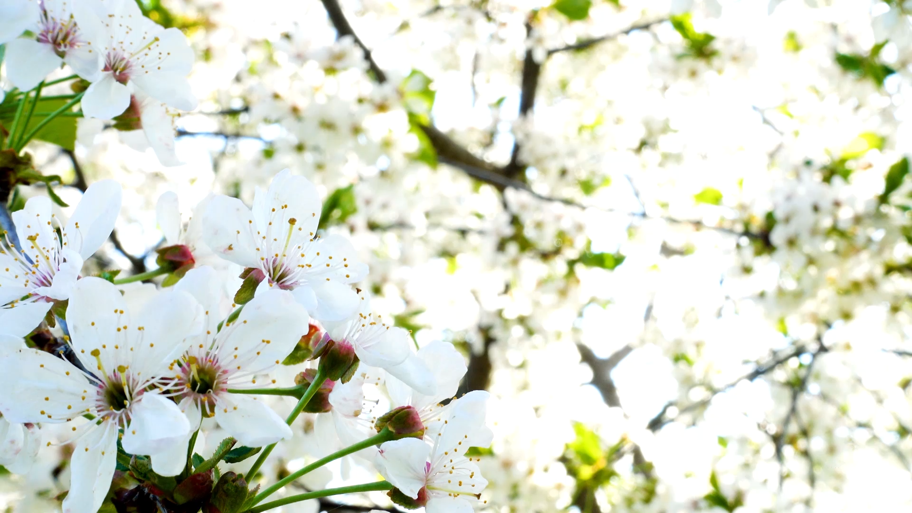
Happy Spring Equinox!
21 Mar 2022

